Slide 1

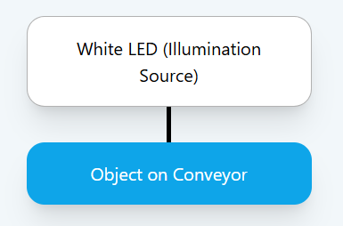
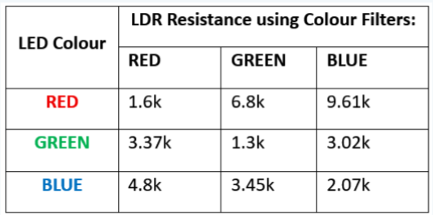
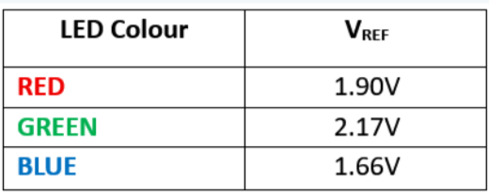
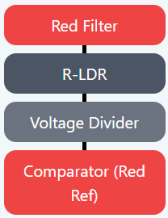
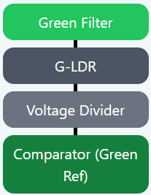
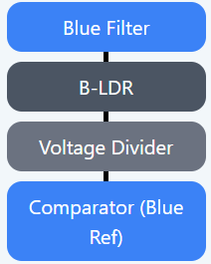
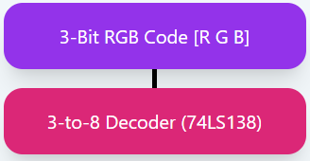

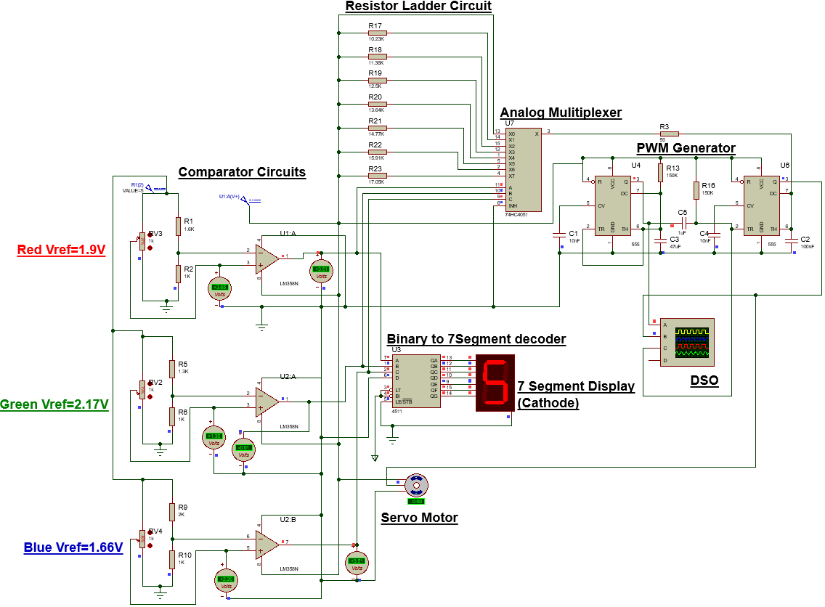
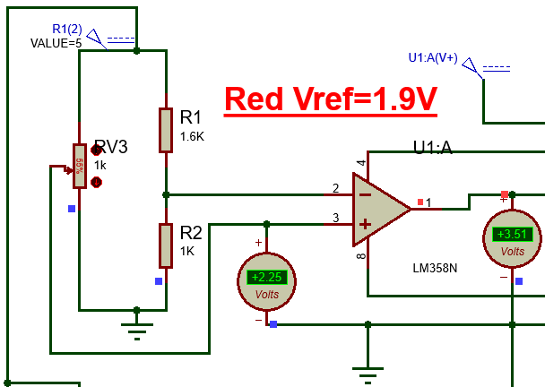
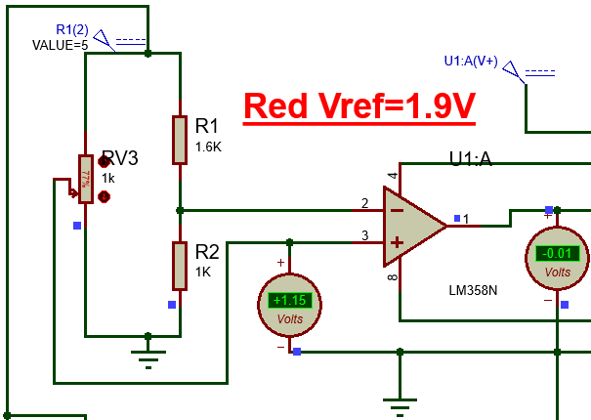
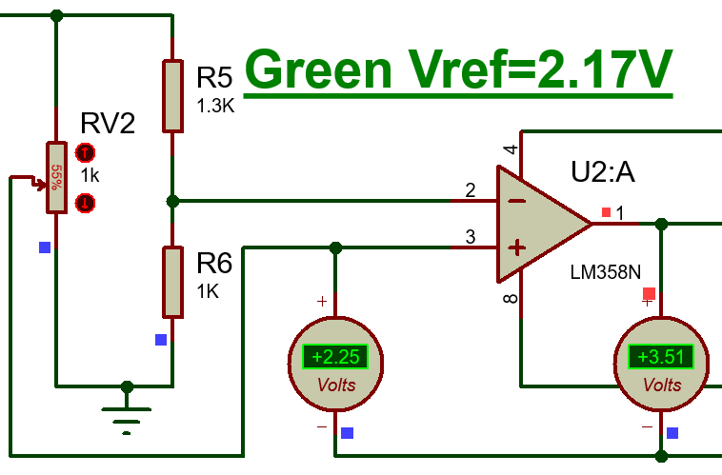
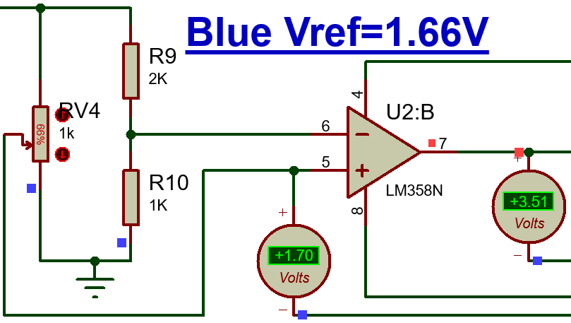
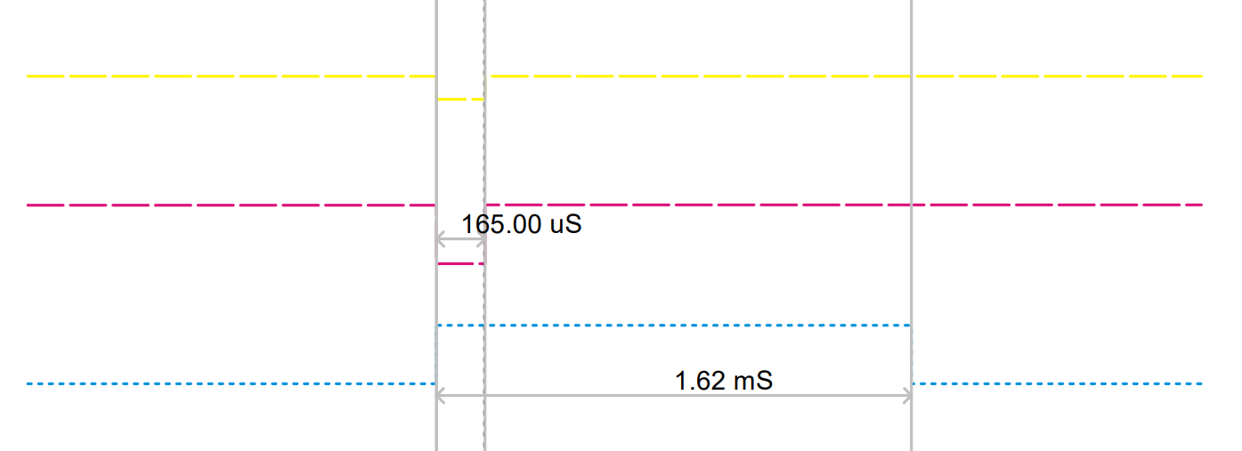
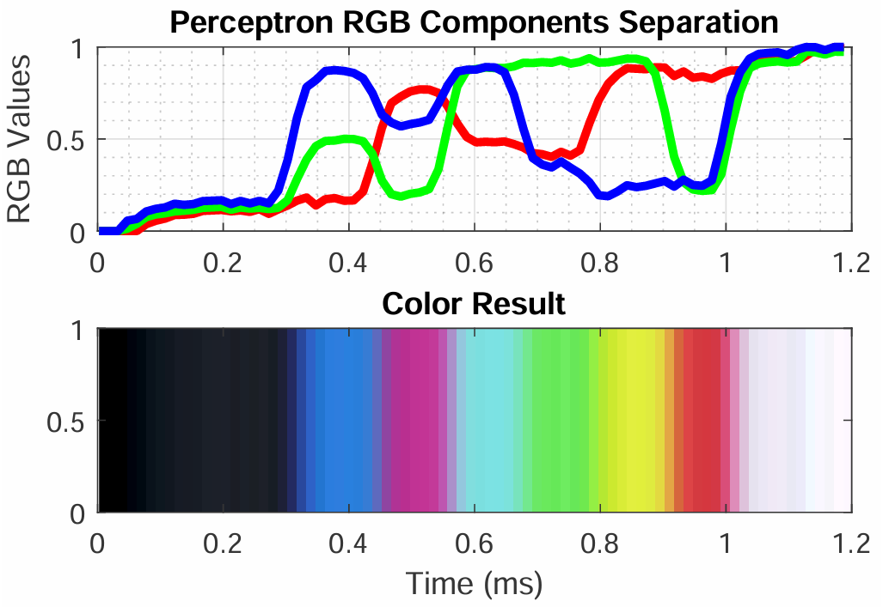
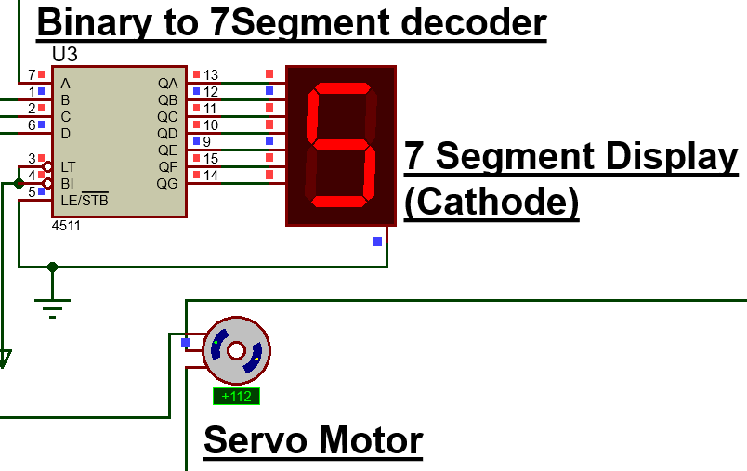
Department of Electronics and Communication Engineering
Amrita School of Engineering, Coimbatore - 641112
Batch ID - A2
  B.Tech –ECE
  23ECE381 Open Laboratory – I
Exhibition Date:11/10/25
LDR Logic-Based Color Detection and Sorting System
CB.EN.U4ECE23002 – Aathithya Pranav
CB.EN.U4ECE23004 – Adarsh B
CB.EN.U4ECE23016 – Ezhilkirthik M
PROBLEM STATEMENT
CIRCUIT DIAGRAM /ALGORITHM
RESULTS
In industrial and laboratory environments, automated color detection and sorting of objects is often performed using microcontroller-based systems, which require programming, firmware, and complex software integration. Such reliance on microcontrollers can increase system cost, complexity, and power consumption, and may limit reliability in harsh or resource-constrained environments.
The challenge addressed in this project is to design and implement a real-time, microcontroller-free color detection and sorting system capable of accurately identifying and classifying multiple colors—specifically Red, Green, Blue, Cyan, Yellow, Magenta, and White—using only analog and digital electronic components. The system must operate autonomously, converting reflected light from objects on a conveyor belt into digital signals, and then driving mechanical actuators to sort objects into corresponding bins with precise timing, all without software or embedded programming.
This problem requires integrating optical sensing, signal conditioning, voltage comparison, digital logic decoding, and actuator control into a cohesive system that is reliable, low-cost, and capable of real-time operation.
7 Segment Display Code | Blue | Green | Red | Output | Servo Rotation (°) | Pulse Width (ms)
0 | 0 | 0 | 0 | Black | 0 | 1
1 | 0 | 0 | 1 | Red | 22.5 | 1.125
2 | 0 |  | 0 | Green | 45 | 1.25
3 | 0 |  | 1 | Yellow | 67.5 | 1.375
4 |  | 0 | 0 | Blue | 90 | 1.500
5 | 1 | 0 | 1 | Magenta | 112.5 | 1.625
6 | 1 | 1 | 0 | Cyan | 135 | 1.75
7 | 1 | 1 | 1 | White | 157.5 | 1.875
1
1
1
1
1
1
1
1
1
1
1
1
Servo Rotation (°) | Pulse Width (ms) | Resistor Values (R) | T = 1.1*(R)*C
0 | 1 | 0 | 1
22.5 | 1.125 | 10.23K | 1.122
45 | 1.25 | 11.36K | 1.248
67.5 | 1.375 | 12.5K | 1.375
90 | 1.500 | 13.64K | 1.5
112.5 | 1.625 | 14.77K | 1.628
135 | 1.75 | 15.91K | 1.749
157.5 | 1.875 | 17.05K | 1.8755
.
APPROACH / DESIGN/ METHODOLOGY
SIMULATION RESULTS
REFERENCES
Illumination: A high-intensity white LED provides uniform lighting for objects on a motorized conveyor belt.
Optical Sensing: Three LDRs behind Red, Green, and Blue filters detect reflected light to isolate RGB components.
Analog Signal Conversion & Conditioning: LDR resistance changes are converted to analog voltages via voltage dividers.
Threshold Detection: Comparators compare conditioned signals against reference voltages to produce digital outputs for each color.
Digital Decoding: The 3-bit RGB code from comparators is decoded via a 3-to-8 line decoder to identify one of eight colors.
Actuation & Sorting: A 180°servo with 1:2 gearing rotates the top platform 360° to align the correct bin with the conveyor for sorting.
Timing Control: A 555 timer-based monostable circuit synchronizes object position with servo motor rotation.
[1] I. Mazumdar, R. Mondal, and S. Pal, “Design and development of a low cost colour sensor and its application in angular position control system of a stepper motor,” Int. J. Electron. Comput. Sci. Eng., vol. 2, no. 4, pp. 1241–1251, 2013.
[2] T. K. Binnar, D. D. Deoghare, P. N. Patil, and V. S. Kulkarni, “Designing of RGB color detector,” Int. J. Recent Dev. Eng. Technol., vol. 3, no. 2, p. 12, Aug. 2014.
[3] M. Petersen et al., “Conveyor line color object sorting using a monochrome camera, colored light and RGB filters,” in Proc. 23rd Annu. Hawaii Int. Conf. Educ., Honolulu, HI, USA, Jan. 4–7, 2025.
[4] A. Amhani and Z. Iqbal, “Automated color sensor system using LDR and RGB LEDs controlled by Arduino,” ARPN J. Eng. Appl. Sci., vol. 12, no. 19, pp. 5532–5535, Oct. 2017.
[5] H. Zhang and J. Li, "Design of a low-cost four-channel LDR-based line-follower sensor with transient and external interference compensations," Sensors, vol. 20, no. 4, p. 1111, 2020.
[6] Virtual Labs, IIT Roorkee, “Astable and Monostable Multivibrator,” Virtual Labs. [Online]. Available: https://ae-iitr.vlabs.ac.in/exp/astable-monostable-multivibrator/theory.html. [Accessed: Sep. 18, 2025].
Astable Output
Monostable Trigger Input
Servo Motor Pulse Input

